Slide 1
SDW update
SDW re-charter
GeoDCAT deliverable
potential for related WoT profiles
Integration of OGC and application domains
FIWARE model examples
“Cross domain model”

Slide 2
Spatial Data on the Web WG
Fspl3brmfasPFw88s
Joint W3C/OGC
Purpose
Original charter scope
Re-charter
Proposed mechanism

Slide 3
Purpose
Fspl3brmfasPFw88s
A means to allow W3C and OGC membership to collaborate in specification development.
Intended to act as a forum for considering common interests.
- but has not been active in this role in general

Slide 4
Original charter
Fspl3brmfasPFw88s
based on “Semantic Sensor Network” alignment with OGC/ISO “Observations and Measurements”
Derived basic ontology: “Sensor, Observation, Sample, and Actuator (SOSA)”
SSN retained axioms and details of system characteristics
Some related work published as notes – e.g. use in RDF DataCube
Expired mid 2024

Slide 5
Re-charter
Fspl3brmfasPFw88s
About to go out for public comment
https://w3c.github.io/charter-drafts/2024/sdw-wg.html
“Work with OGC Standard Working Groups to jointly develop, maintain and promote geospatial Web standards and geospatial profiles of more general Web standards”
SOSA/SSN
GeoDCAT
GeoSPARQL 1.3/2.x

Slide 6
Other..
How might WoT relate to..
“Connected Systems” – OpenAPI version of “Sensor Web Enablement” model?
https://www.ogc.org/requests/ogc-requests-public-comment-on-ogc-api-connected-systems-and-supporting-sensor-standards-before-adoption/
Note on alignment? JSON-LD contexts? Testing?
Sensor Things API v2 planned… can we align better?
CityGML -> OWL representation (and profiles)
Digiital Twins WG – recharted – open to work items?
(https://www.ogc.org/about-ogc/committees/dwg/urban-digital-twins-domain-working-group/)

Slide 7
GeoDCAT
DCAT (W3C DXWG) does not define
Any specific profiles
Any profiling mechanism
GeoDCAT is a WIP of a Geospatial Profile
EU already published a GeoDCAT-AP
But Eurocentric and limited in scope
Metadata needs to be far more extensible
GeoDCAT will be a core and register of extension profiles of DCAT
=> analogous to TD profiles – work to be done exploring this?

Slide 8
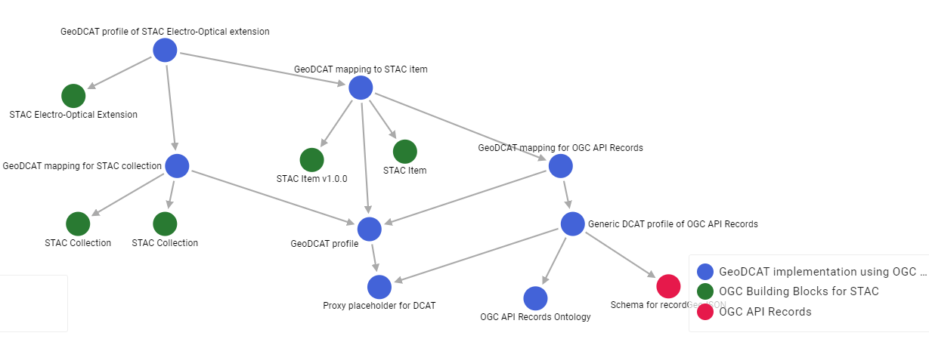
DCAT – a family of profiles
Modules for:
Ontologies
Profile constraints
Schemas
(APIs, Test cases, Transformations)

Slide 9
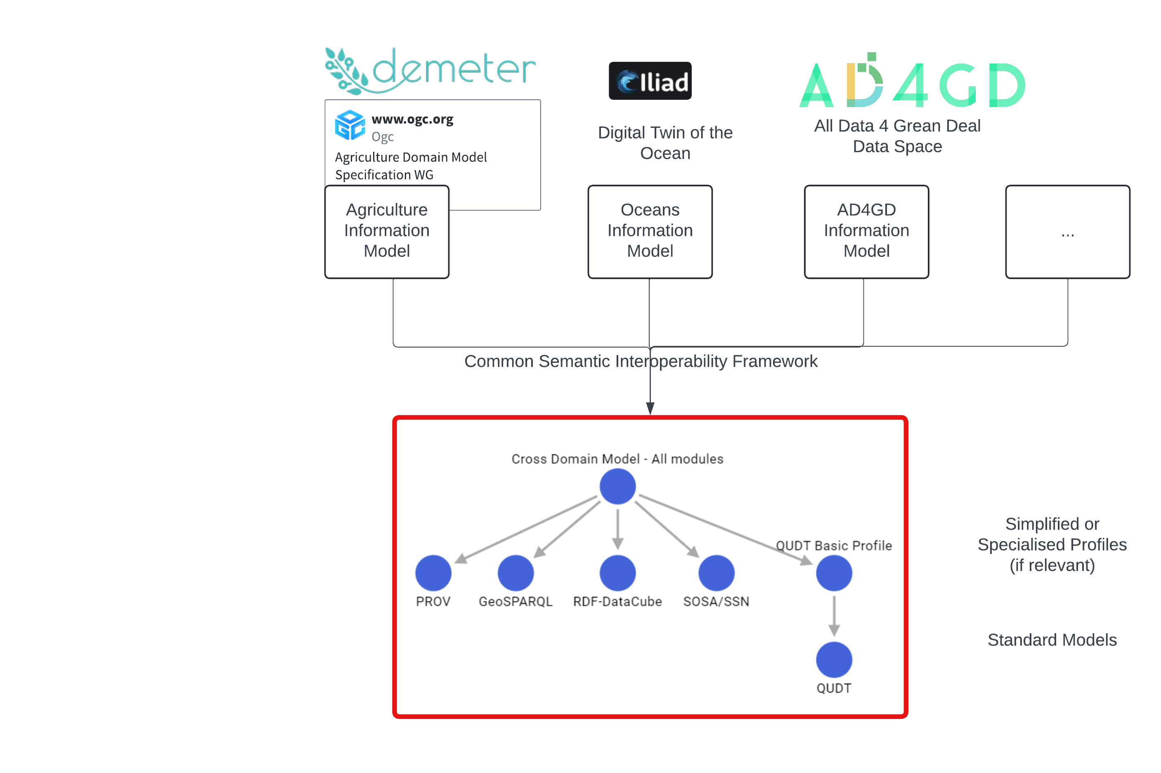
W3C foundations for “domain models”

Slide 10
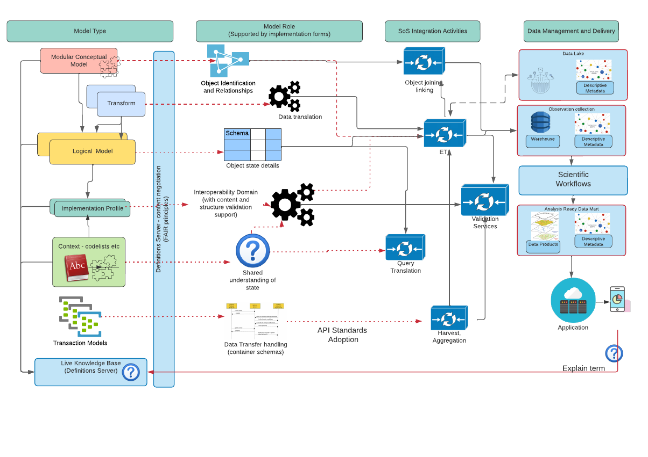
“Systems of Systems” View

Slide 11
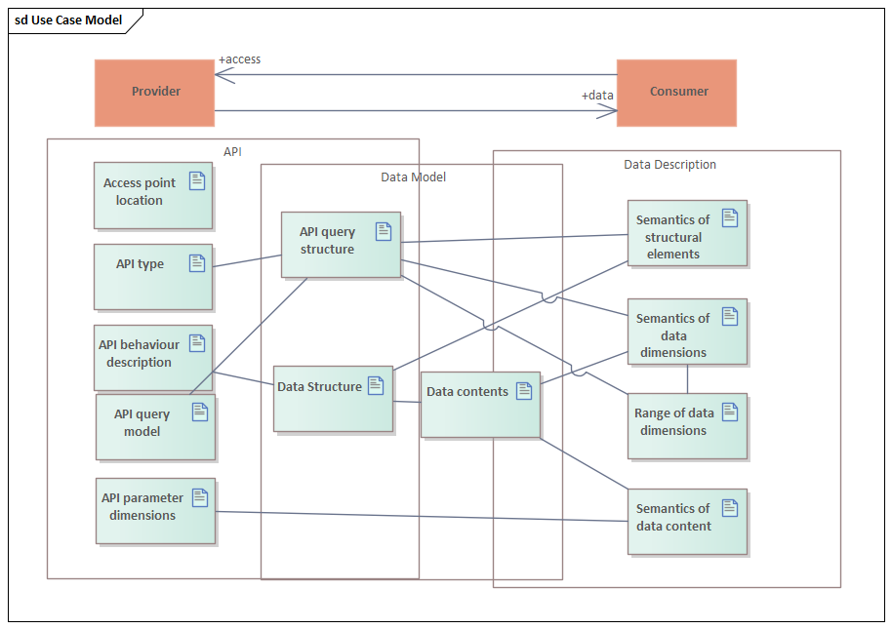
Aspects of data access via an API

Slide 12
Aligning and learning
”Thing Descriptions, by default, are encoded in a JSON format that also allows JSON-LD processing. The latter provides a powerful foundation to represent knowledge about Things in a machine-understandable way.”
(https://www.w3.org/TR/wot-thing-description11/#abstract)
OGC has inherited a legacy where JSON has not been designed this way (IETF GeoJSON
OGC has been evolving a “Building Blocks” model for collections of features – with an initial focus on mapping schema fragments to JSON-LD
Complex, but possible, to aggregate domain models from fragments and retain semantic annotations
Working in background with OpenAPI, JSON-schema on this – can we have a more inclusive forum?

Slide 13
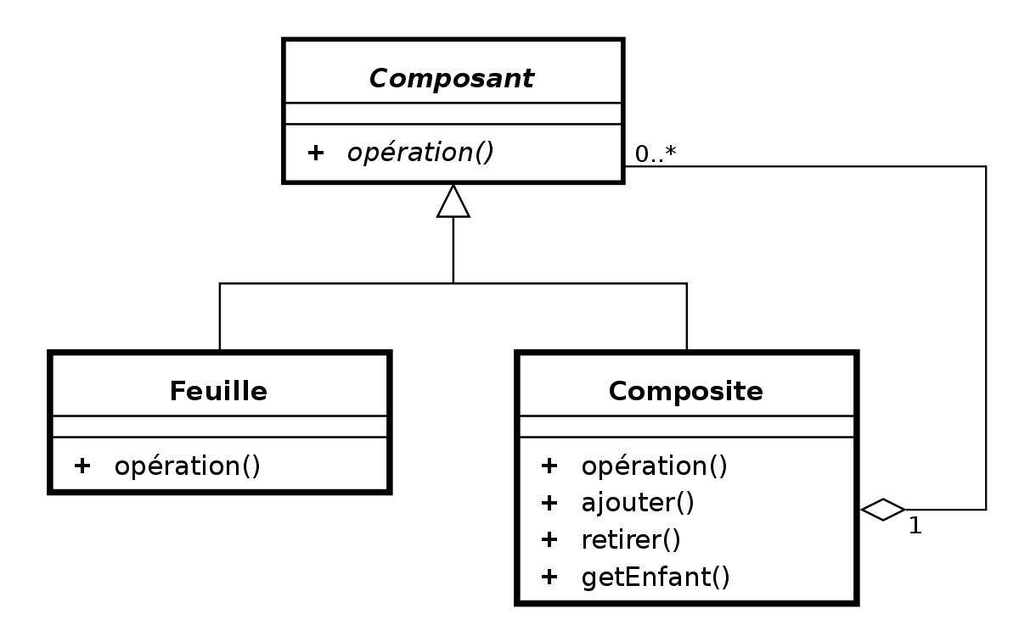
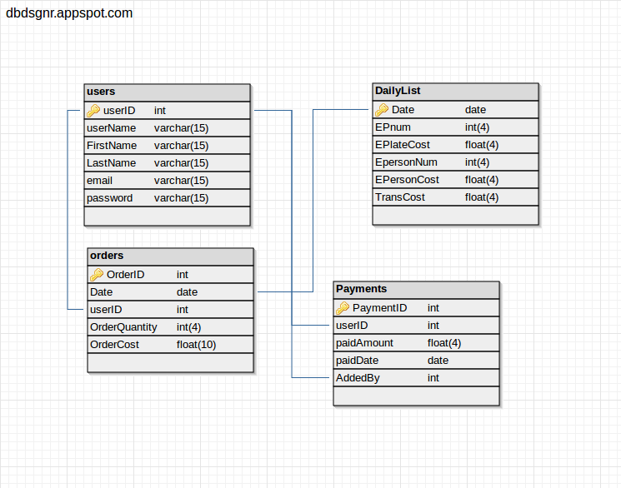

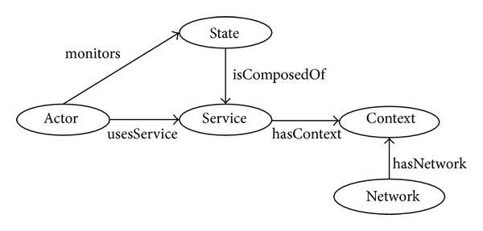
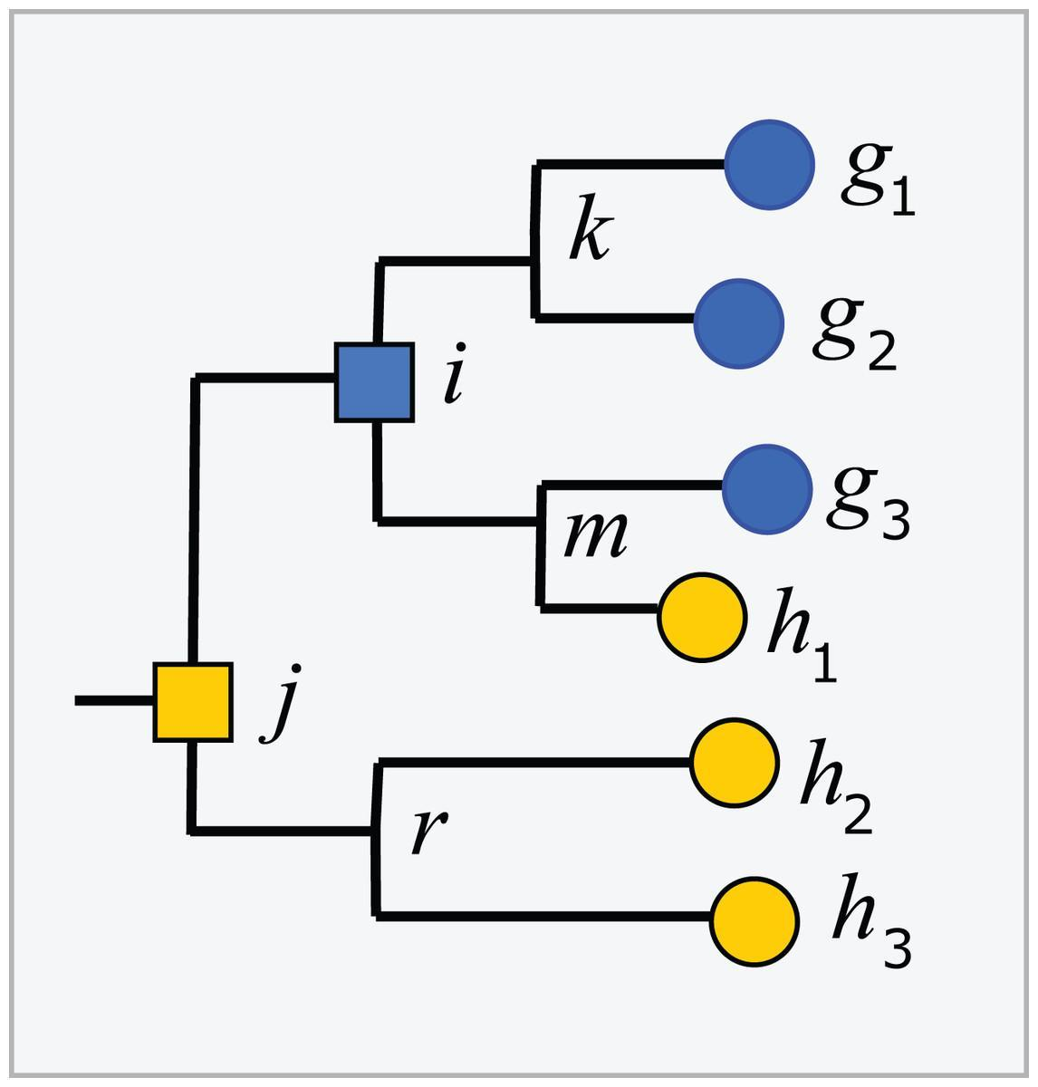
Conceptual model
Implementation model
API
Encoding
WFS
(Feature Type)
GML
UML
OGCAPI-
Features
JSON Schema
SHACL (profiles)
Profile constraints
JSON-LD Context
Definitions
(Linked Data)
SKOS/turtle
OWL/RDFS
Concept
Taxonomy
HTML page

Slide 14
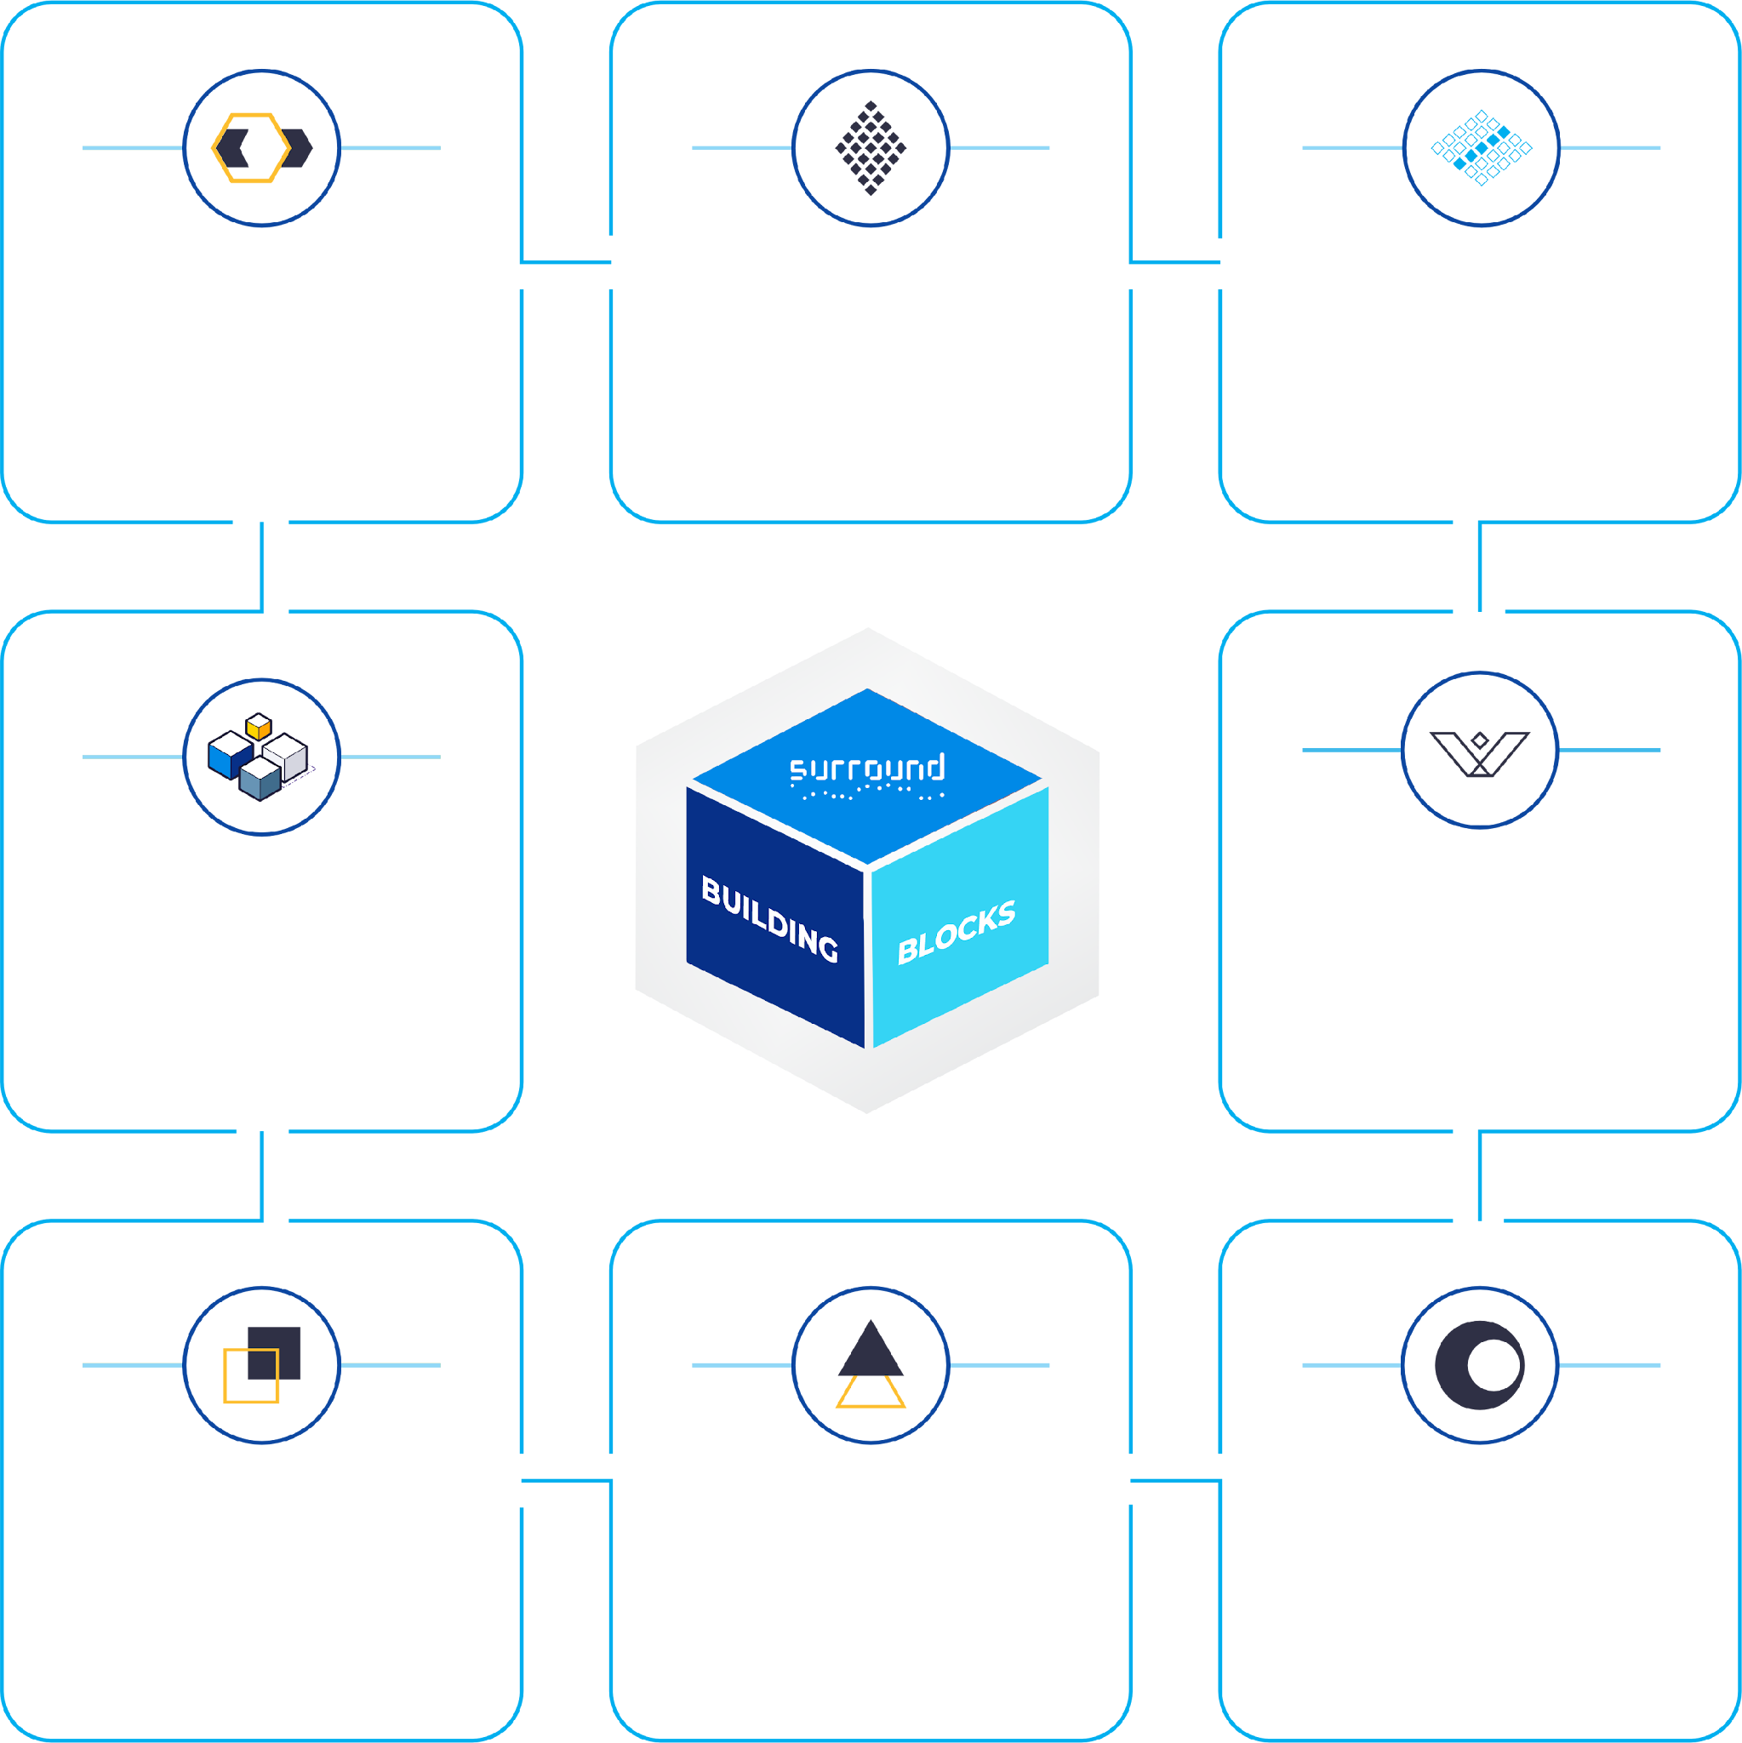


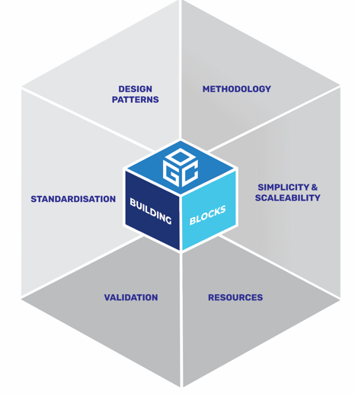
BUILDING BLOCKS
Solution
PROFILING
SCALABILITY
TRACEABILITY &
TRANSPARENCY
Making standards work for specific applications
Cost effective reuse and power to keep on solving new problems
Knowing what works together and what happens in complex systems
SEMANTIC
INTEROPERABILITY
COMPLEX
APPLICATIONS
A better data model and API Design Framework
SURROUND leverages state of the art data models and frameworks to create simplified building blocks that connect enterprise assets seamlessly, simplifying what is usually a rather complex challenge.
System of Systems - Complex
data integration using standards,
structure, meaning and content
Simple parts, complete solutions. Bigger than the “sum of the parts”
RESOURCES
FUTURE
PROOFING
TESTING
Open tooling and libraries of standards and solutions
Support multiple technology versions from one tested design
Best practices applied at all levels provides robust, trustworthy and clearly documented solutions.
14

Slide 15

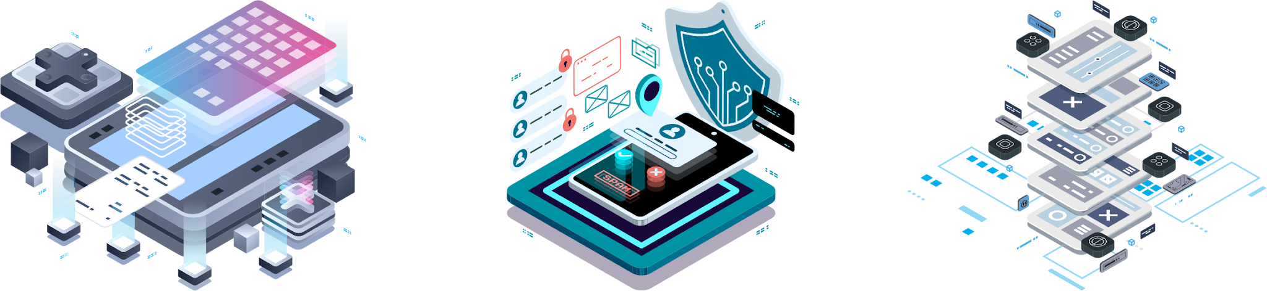
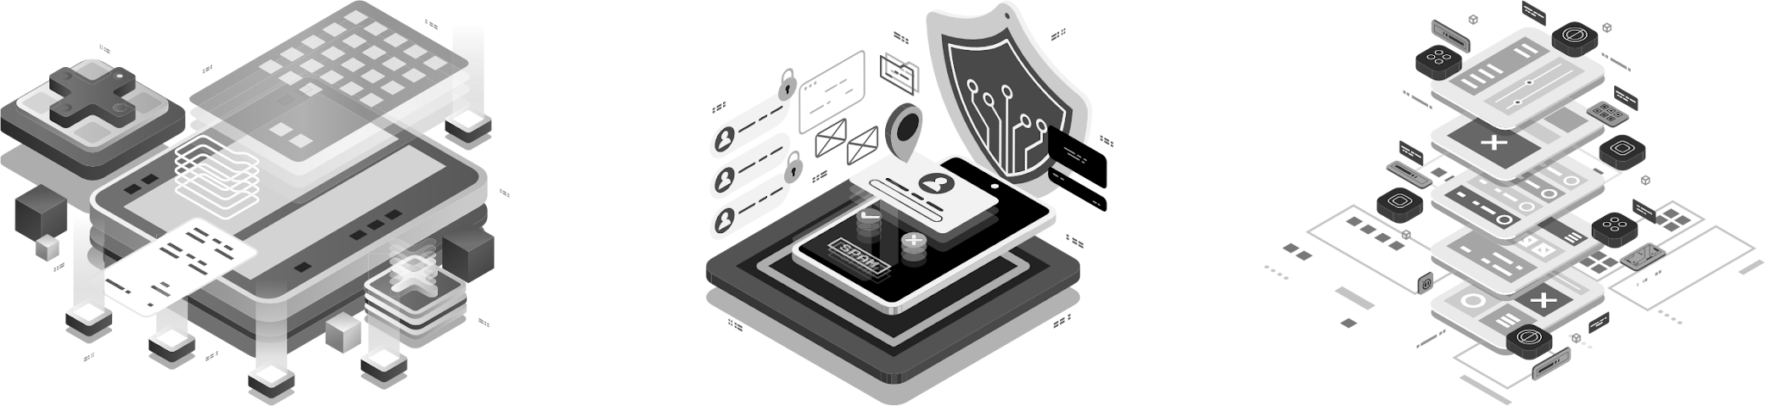
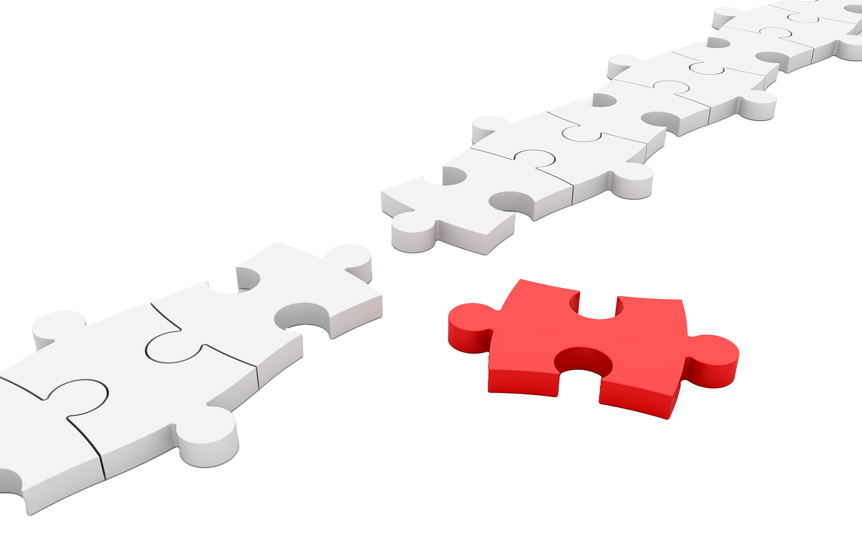


Proprietary model
TRACEABILITY &
TRANSPARENCY
Copy. Paste. Modify.
Invent your own.
Know what you know!
Knowledge graphs can identify how both standards and data is related. This traceability supports both efficiency and transparency, adding value and managing risks for data exploitation and reporting.
Link. Profile. Reuse.
No two applications are the same - but many share common problems.
Copy, paste, modify approaches hide this commonality. Inventing your own hurts you and the client in future.
Reuse via reference (linking) with profiling to explain how the re-use is done makes it all transparent. And is much cheaper to build and test!
The dependency graph is the foundation of a semantic knowledge representation of how system
components can interoperate.

Slide 16
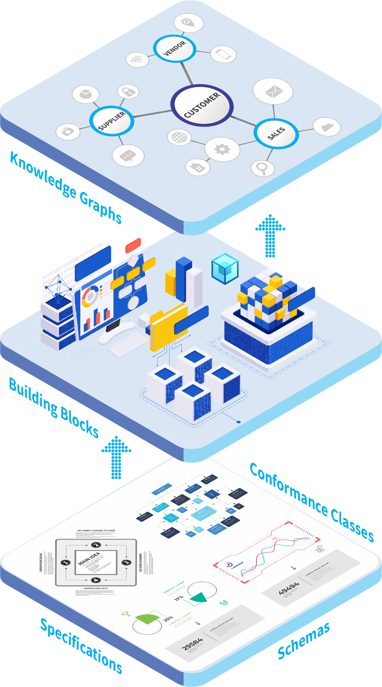



Proprietary model
Knowledge how:
standards relate
Data conforms to standards
Data relates
Services interact with data
SCALABILITY
Many data sources means many challenges
Our approach allows us to identify common aspects and reuse effective solutions, and expand easily to meet specific needs of problem domains.
The bridge between sources and knowledge
How pieces fit together
Documentation and testing
Tools to combine
A large scattered body of complex documentation
Many different forms
Limited, if any, machine-readable information

Slide 17
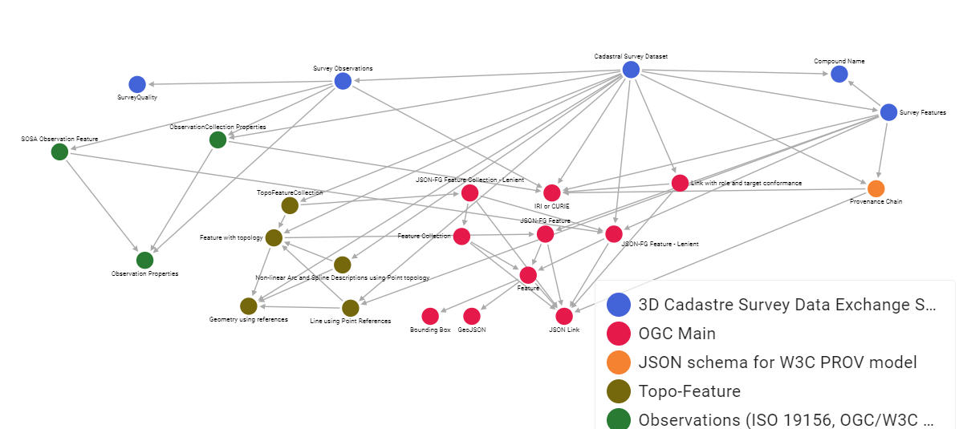

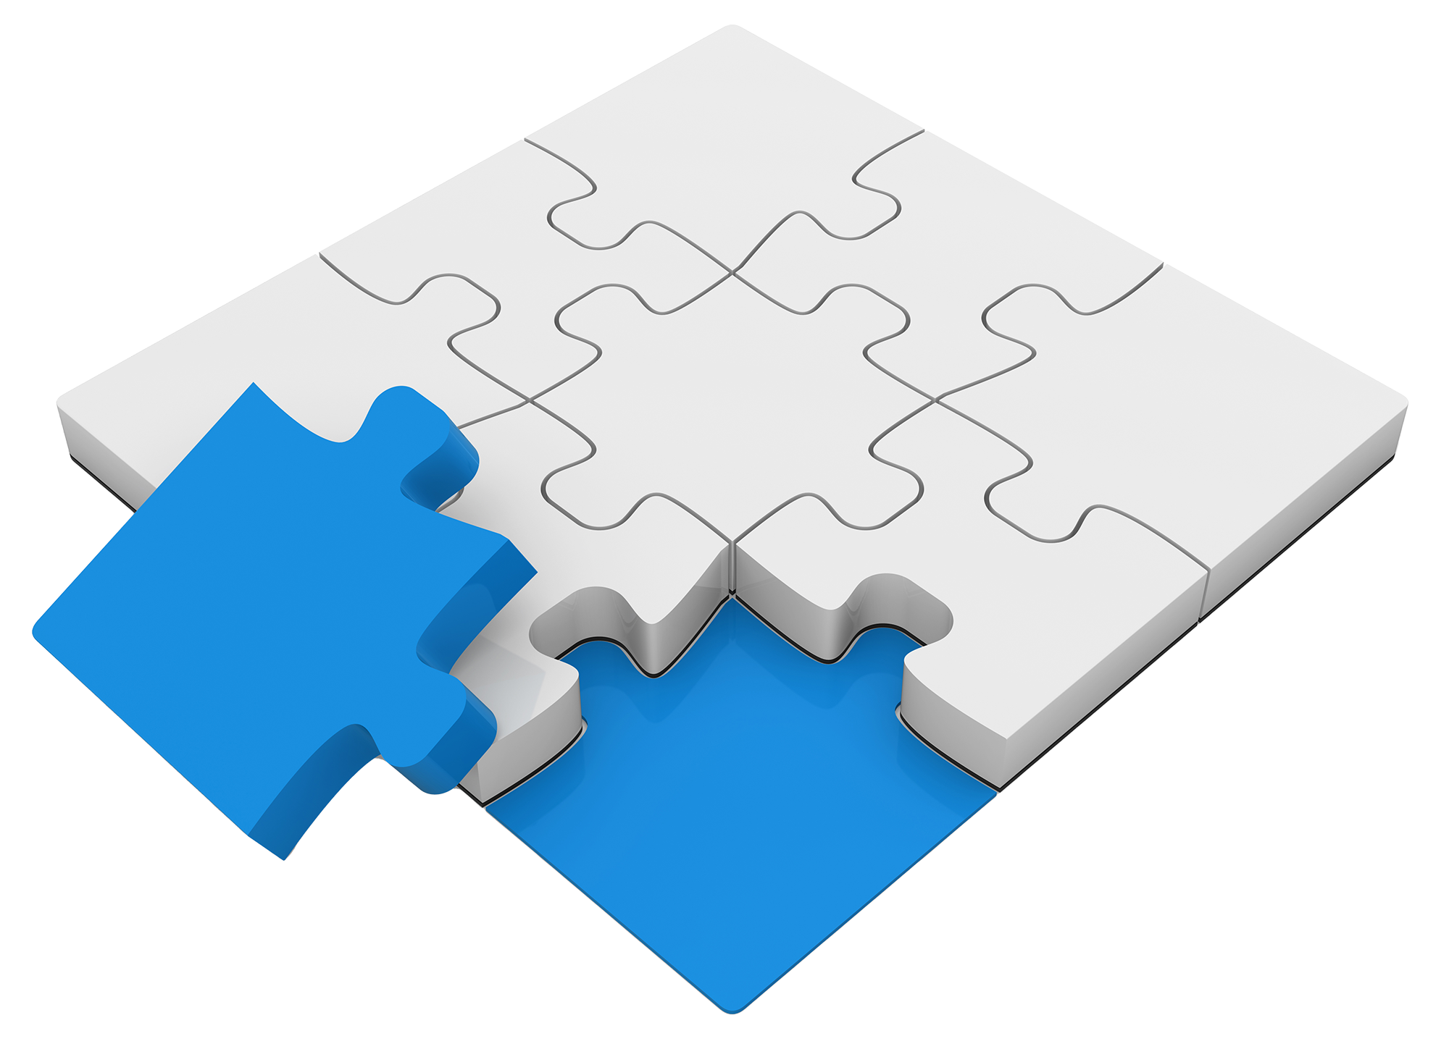
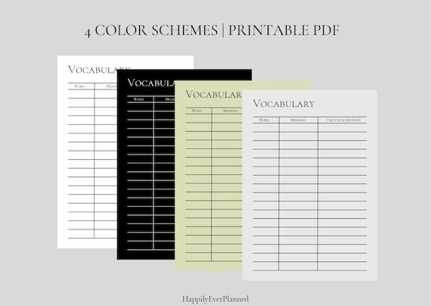
Proprietary model
COMPLEX
APPLICATIONS
Manageable pieces, but unlimited power when combined.
Reuse of well-tested components allows rapid assembly of solutions for arbitrary complex scenarios.
Common vocabularies
Cadastral Survey Data Exchange Model replaces an “one-size-fits-all” XML based solution that failed to fit anyone.
SURROUND, an OGC member, was able to demonstrate with hundreds of test cases that a wide range of special cases could all be handled using standardised Building Blocks and semantic profiling using controlled vocabulary resources.

Slide 18
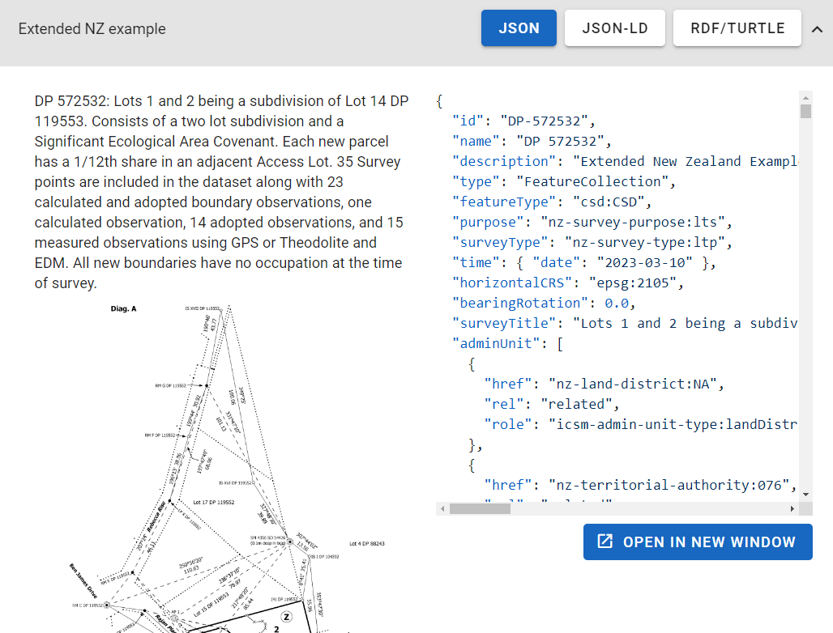
Examples
Many examples
Comprehensive
Single concepts
Edge cases
Failure testing

Slide 19

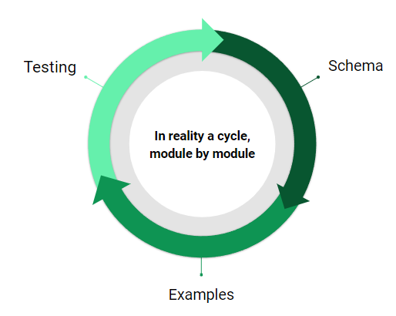

Reuse of modules in other OGC projects
Proprietary model
Standards
TESTING
Confidence through testing
Automated testing procedures allows confidence in solutions. Rapid development is supported both by confidence in testing of reusable components as well the means to test new components and entire solutions.
Schema
Module composition
Unit tests
Fully documented examples for specification, automation tested
Additional test cases - including intended failure tests
Continuous integration / Continuous testing
Inheritance of validation rules when bundling specifications
Extended local rules - e.g. templates must have variables described
Native support for schema and SHACL validations
Extensions with plug-in validators
Transformation testing to/from component to related forms
pass
fail

Slide 20
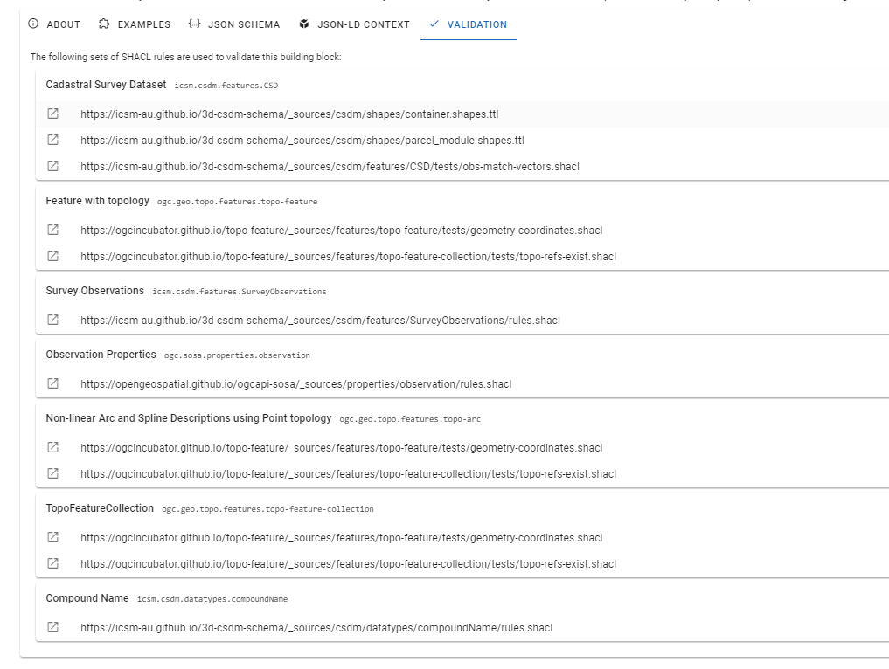
Rules
Complex
Reusable
Automated
(inherited)

Slide 21

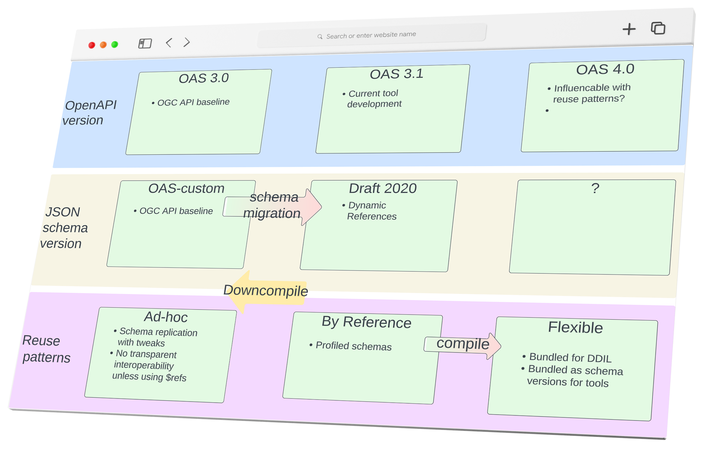
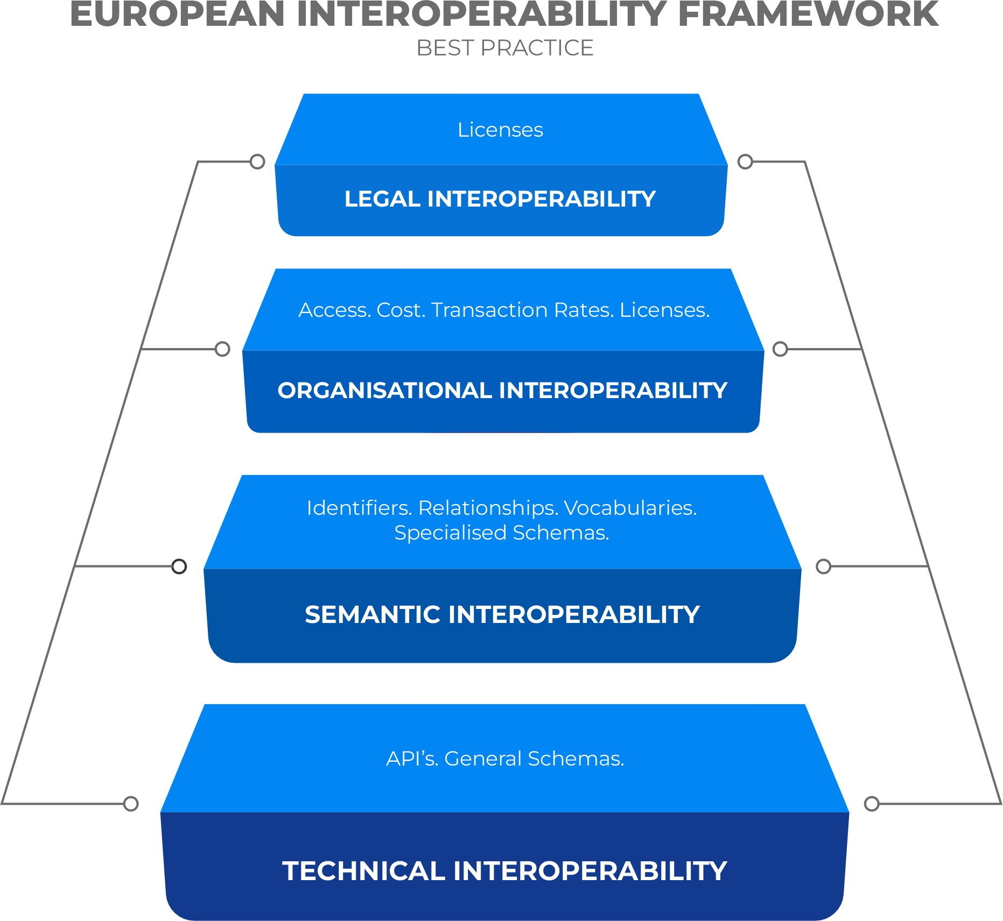
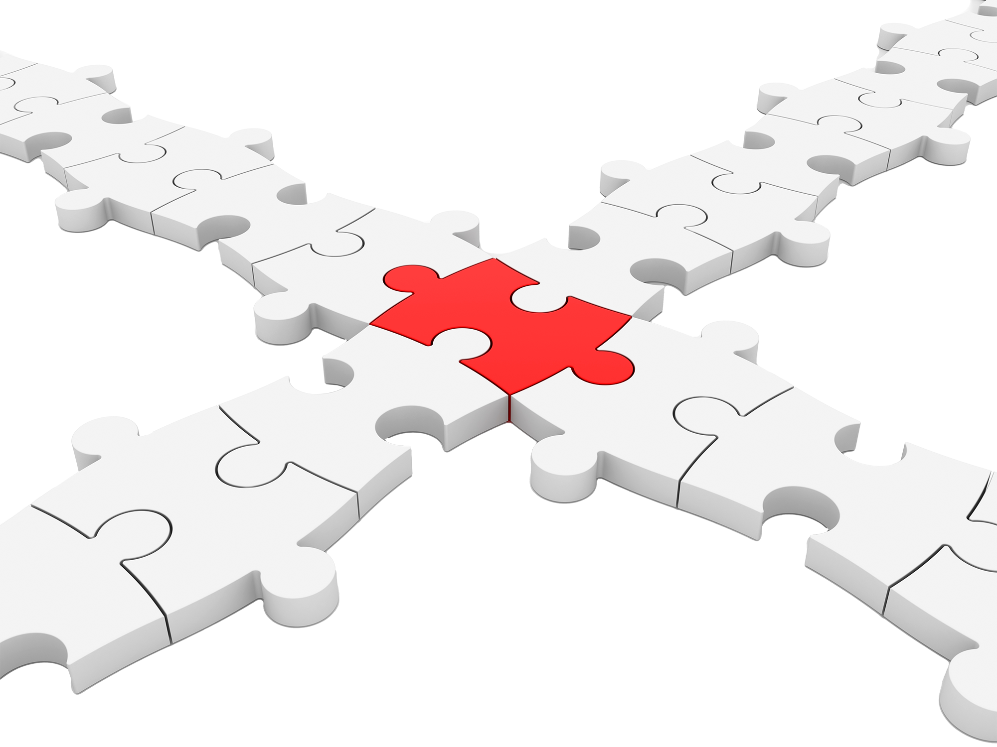
Proprietary model
FUTURE
PROOFING
Technologies change, can you?
Building Blocks can be assembled and easily tested, and updated if necessary, to support new technologies, whilst retaining compatibility with legacy implementations.
The technology that has allowed rapid uptake of API and JSON schemas - OpenAPI 3.0 is widely used - but a OpenAPI 3.1 is already being deployed to address several limitations.
Building Blocks support integration and "transpilation" of components using any or all versions of any technology.
The ability to rigorously test each component individually supports rapid development of support for emerging or future technologies.

Slide 22
Quick example
https://ogcincubator.github.io/bblocks-examples/bblock/ogc.bbr.examples.feature.externalSchema
Wraps a FIWARE schema (with JSON-LD context) in a GeoJSON feature, using a BuildingBlock that provides a context for GeoJSON and an context composition pattern

